Slide 1
PSCS 8- AI-Powered Legal Documentation Assistant
PIP4004: University Project
Review-0 Presentation
Group Number: IST-02
Under the Supervision of,
Ms. MONISHA GUPTA
Assistant Professor
School of Computer Science and Engineering
Presidency University
Roll Number | Student Name
20211IST0002 | M K SUGUNASHREE
20211IST0003 | HUZAIFA SHARIFF
20211IST0020 | SHAMITHA R
Name of the Program: Bachelor Of Technology
Name of the HoD: Dr Pallavi R
Name of the Program Project Coordinator: Mr. Srinivas Mishra
Name of the School Project Coordinators: Dr. Sampath A K / Dr. Abdul Khadar A / Mr. Md Ziaur Rahman

Slide 2
Content
Problem Statement
Github Link
Analysis of Problem Statement
Timeline of the Project
References

Slide 3
Problem Statement Number:
Organization: Ministry Of Law and Justice
Category (Hardware / Software / Both) : Software
Problem Description : Legal documentation can be a complicated and time-consuming process, especially for individuals and small businesses who may not have access to legal resources. In addition, the language and jargon used in legal documents can be difficult for non-lawyers to understand, which can lead to errors and misunderstandings. Objective: The objective of this hackathon challenge is to develop an AI-powered solution that can simplify legal documentation for individuals and small businesses in India, by automatically drafting legal documents in plain language and using easy-to-understand terms.

Slide 4
Potential Features:
1. User-friendly interface for inputting relevant information such as parties involved, terms of the agreement, and other necessary details.
2. AI-powered document generation that automatically drafts legal documents in plain language and using easy-to-understand terms.
3. Ability to customize legal documents based on the specific needs of the user.
4. Integration with existing legal resources and databases to ensure accuracy and completeness of the legal documents.
5. Option for users to seek legal advice from an expert in case of complex legal issues.

Slide 5
Impact:
The proposed solution can greatly benefit individuals and small businesses in India, who often face challenges with legal documentation due to limited access to legal resources. By simplifying legal documentation, this solution can potentially save time, reduce errors, and increase access to justice. Data: Participants can use publicly available legal databases and resources to train the AI model for document generation.
Deliverables:
A working prototype of the AI-powered legal documentation assistant, demonstrating its functionality and ease of use.
2. A presentation outlining the features and potential impact of the solution, as well as its technical architecture and data requirements.
3. Code and documentation for the solution, along with instructions for deployment and maintenance.

Slide 6
Note: Participants are encouraged to consider the ethical implications of their solution and to prioritize data privacy and security.
Difficulty Level: Simple

Slide 7
Github Link
The Github Link provided should have public access permission
Github Link
https://github.com/shamiy/Legal-Documentation-assistant.git

Slide 8
Analysis of Problem Statement
Technology Stack Components: Software - Web App development
Frontend: HTML/CSS/JavaScript .
Backend : Flask
Database: MySQL
Hosting & Cloud: AWS ,Google Cloud, Azure.
Security: SSL/TLS encryption.

Slide 9
Analysis of Problem Statement (contd...)
Software Requirements:
User Interface (UI): Simple, easy-to- use interface for inputting legal details.
AI-based Documentation Generation: Automatically drafts legal documents based on input.
Legal Language Simplification: Converts complex legal terms into plain language.
Customizable Templates: Provides access to legal Professionals if needed.
Integration with Legal Databases: Ensures document accuracy and compliance with legal standards.

Slide 10
Analysis of Problem Statement (contd...)
Security and Privacy: Protects user data with encryption and secure access controls.
Scalability: Supports multiple users and document types efficiently.

Slide 11
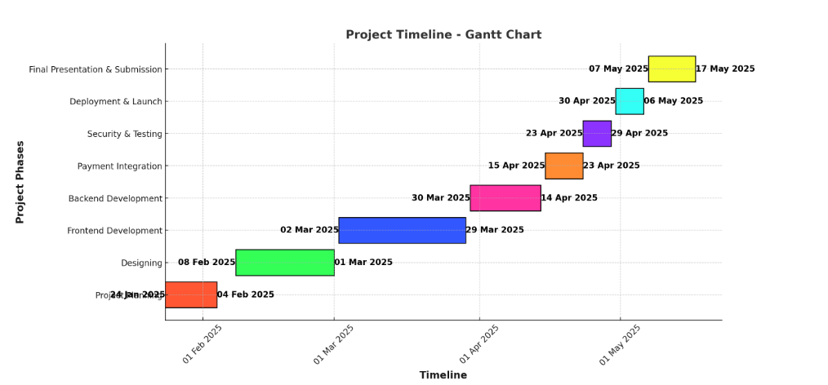
Timeline of the Project (Gantt Chart)

Slide 12
References (IEEE Paper format)
Sharma, H., & Aakanksha, N. (2021). Artificial Intelligence and Law: an effective and efficient instrument. 2022 10th International Conference on Reliability, Infocom Technologies and Optimization (Trends and Future Directions) (ICRITO), 1–5. https://doi.org/10.1109/icrito51393.2021.9596503
Baviskar, D., Ahirrao, S., Potdar, V., & Kotecha, K. (2021). Efficient automated processing of the unstructured documents using artificial intelligence: A systematic literature review and future directions. IEEE Access, 9, 72894–72936. https://doi.org/10.1109/access.2021.3072900
Maher, S. K., Bhable, S. G., Lahase, A. R., & Nimbhore, S. S. (2022b). AI and Deep Learning-driven Chatbots: A Comprehensive Analysis and Application Trends. 2022 6th International Conference on Intelligent Computing and Control Systems (ICICCS), 994–998. https://doi.org/10.1109/iciccs53718.2022.9788276
Murugesan, S., & Cherukuri, A. K. (2023). The rise of generative artificial intelligence and its impact on education: the promises and perils. Computer, 56(5), 116–121. https://doi.org/10.1109/mc.2023.3253292

Slide 13
Popenici, S. a. D., & Kerr, S. (2017). Exploring the impact of artificial intelligence on teaching and learning in higher education. Research and Practice in Technology Enhanced Learning, 12(1). https://doi.org/10.1186/s41039-017-0062-8
K. Vayadande, A. Bhat, P. Bachhav, A. Bhoyar, Z. Charoliya and A. Chavan, "AI-Powered Legal Documentation Assistant," 2024 4th International Conference on Pervasive Computing and Social Networking (ICPCSN), Salem, India, 2024, pp. 84-91, doi: 10.1109/ICPCSN62568.2024.00022.

Slide 14


